Slide 1
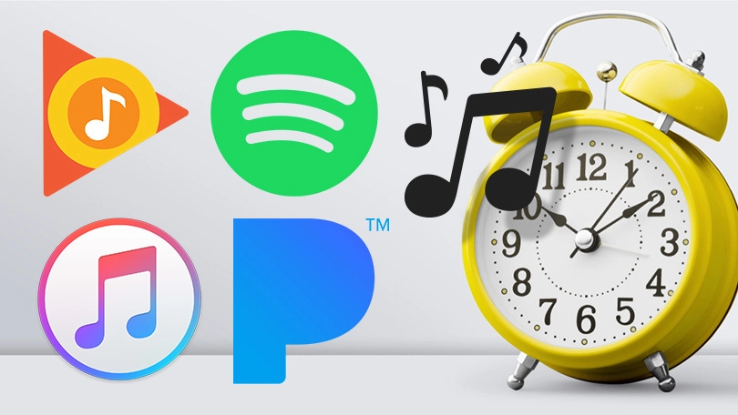
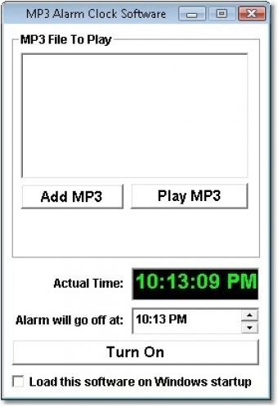
CHRONO
BEATZ
By Johnny Mahone
Replace your devices boring alarm sounds with your favorite music!

